Slide 1
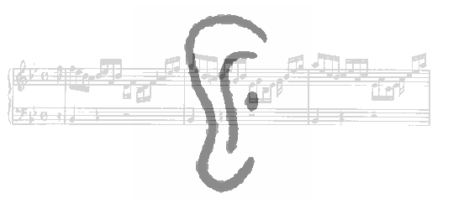
CogSci 307: Auditory Perception
Daniel Pressnitzer
Laboratoire des Systèmes Perceptifs, CNRS
& Département d’études cognitives, Ecole normale supérieure
29 rue d’Ulm, 75230 Paris cedex 05
daniel.pressnitzer@ens.fr

Slide 2
Overview
I. Methods and concepts acoustics, psychophysics, physiology
II. Basic characteristics and applications audible range, masking, critical band, non-linearities, MP3, implants
III. Perceptual attributes loudness, pitch, timbre, location
IV. Seminar auditory scene analysis, illusions, memory

Slide 3
Overview
I. Methods and concepts acoustics, psychophysics, physiology
II. Basic characteristics and applications audible range, masking, critical band, non-linearities, MP3, implants
III. Perceptual attributes loudness, pitch, timbre, location
IV. Seminar auditory scene analysis, illusions, memory

Slide 4
Acoustics
Perception : use acoustic information to guide behavior

Slide 5
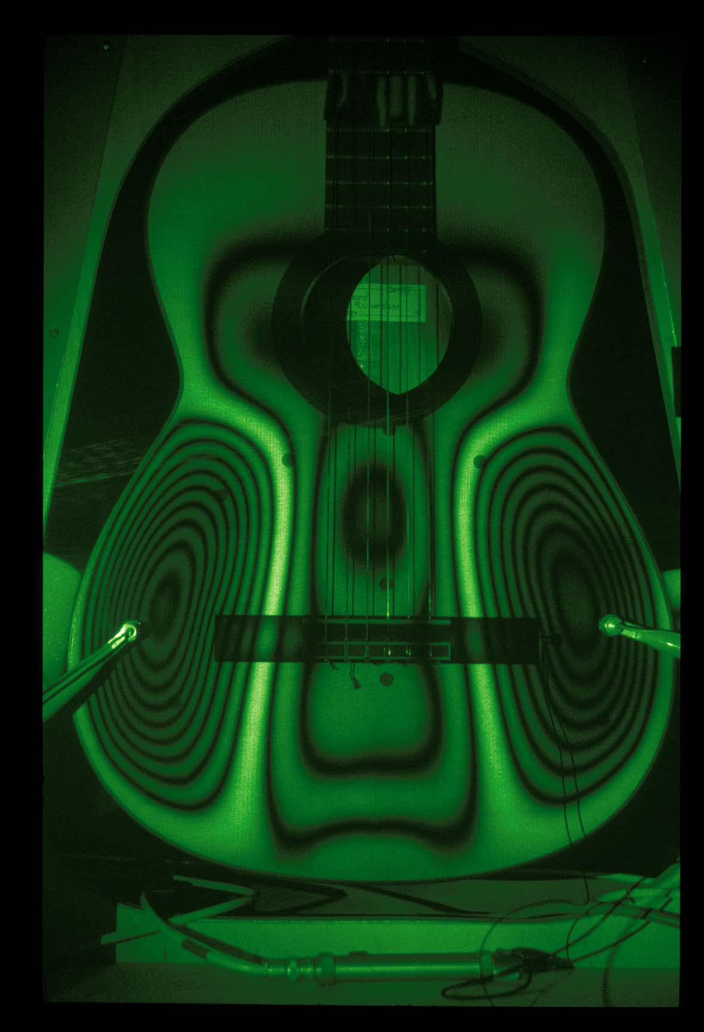
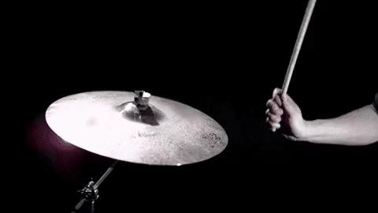
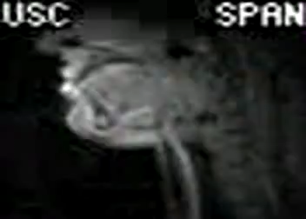
Sound representation
A vibrating object out in the world
Vibration constrained by shape, material, mode of excitation

Slide 6
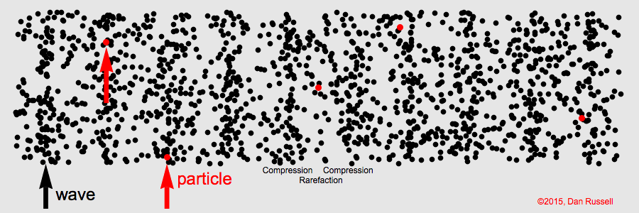
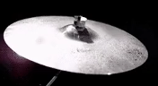
Sound representation
Propagates as an acoustic wave
-> How to represent such a wave?
http://waitbutwhy.com/2016/03/sound.html

Slide 7
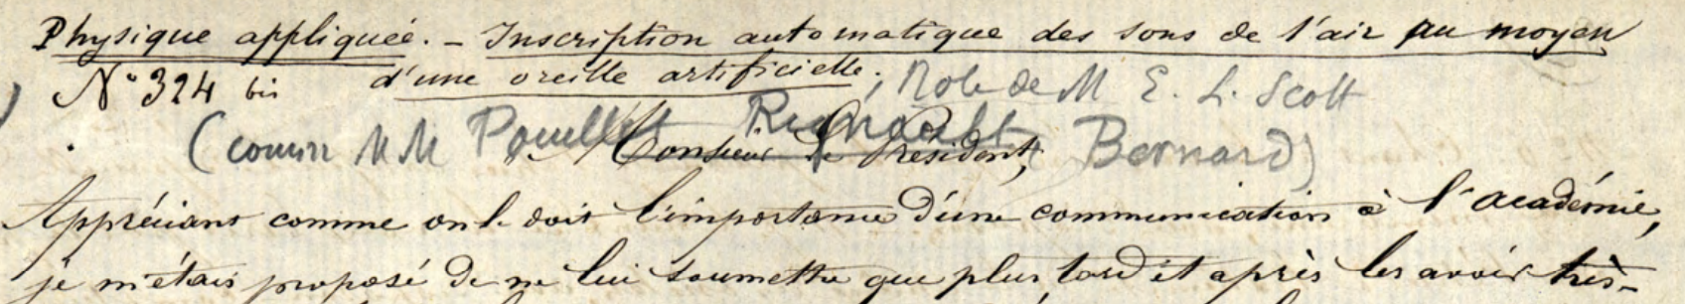
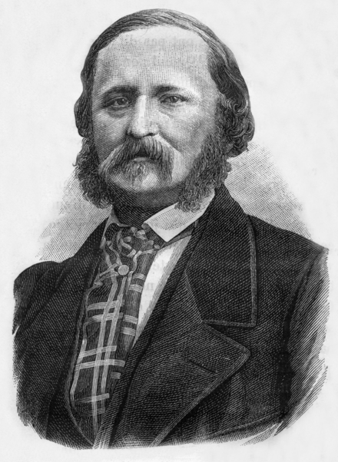
Sound representation
Édouard-Léon Scott de Martinville (1817-1879)
The « phonautograph »
First visualisation of the sound of the voice (April 9 1860)
http://www.tremblingsandwarblings.com/2017/01/the-voice-in-the-soot/
http://www.firstsounds.org/sounds/scott.php

Slide 8
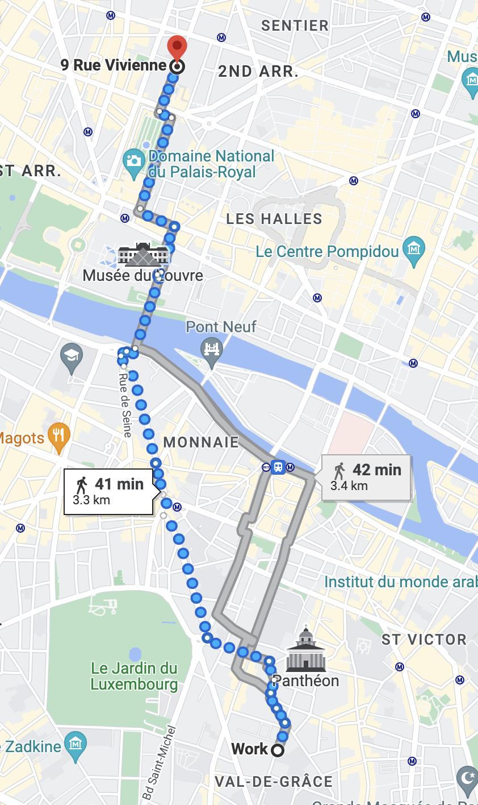
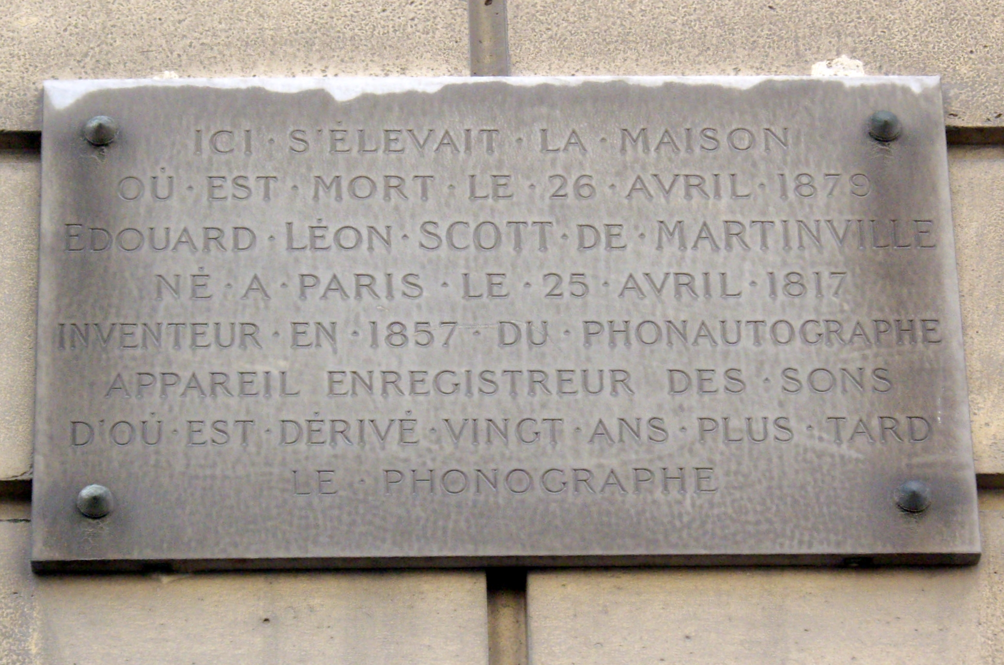
Sound representation
The « phonautograph »
First visualisation of the sound of the voice (April 9 1860)
http://www.tremblingsandwarblings.com/2017/01/the-voice-in-the-soot/
http://www.firstsounds.org/sounds/scott.php

Slide 9
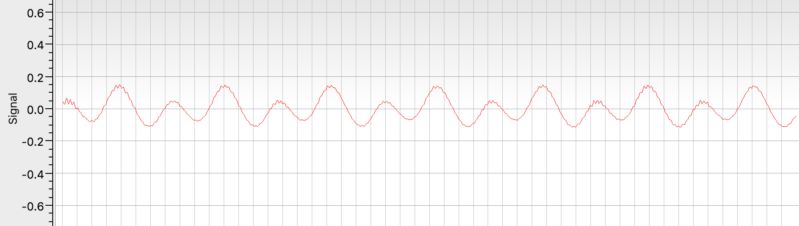
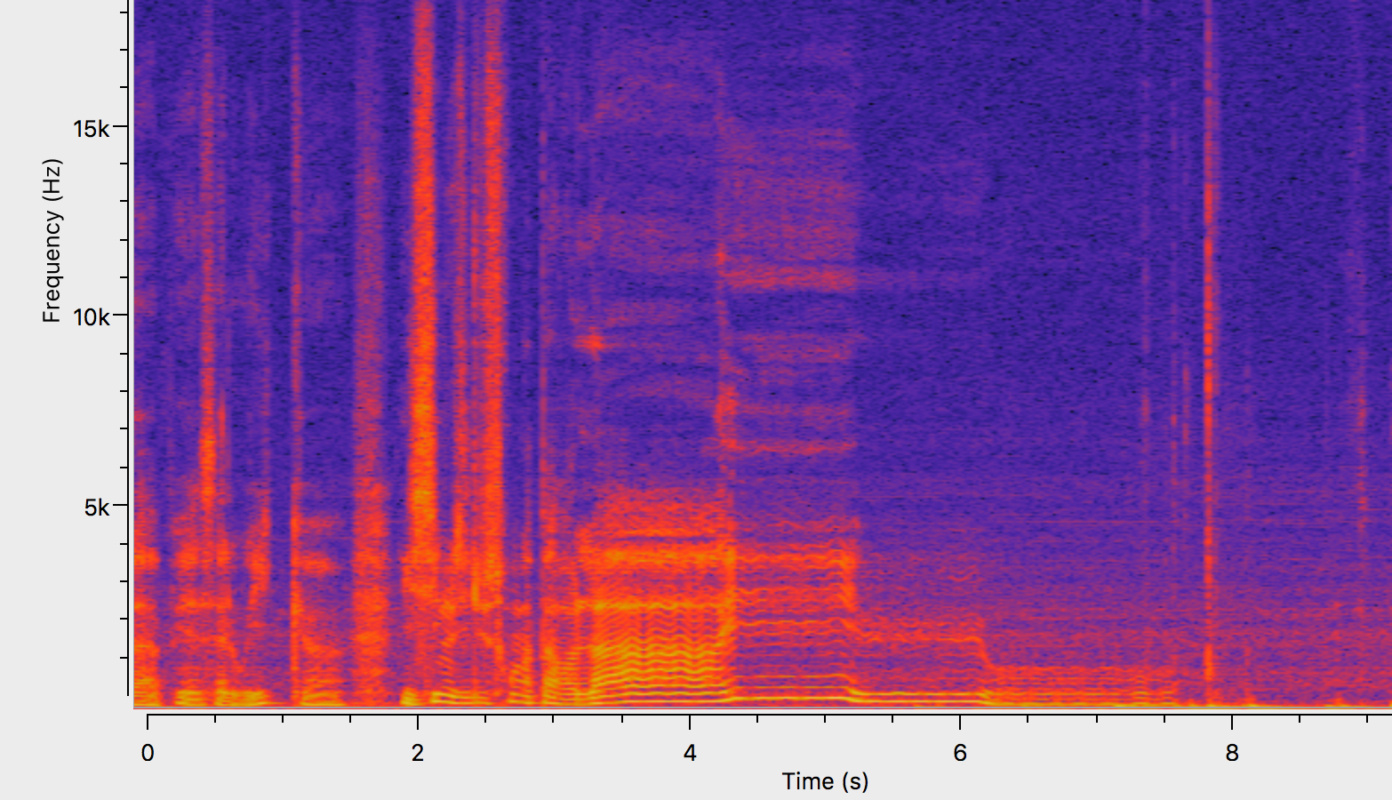
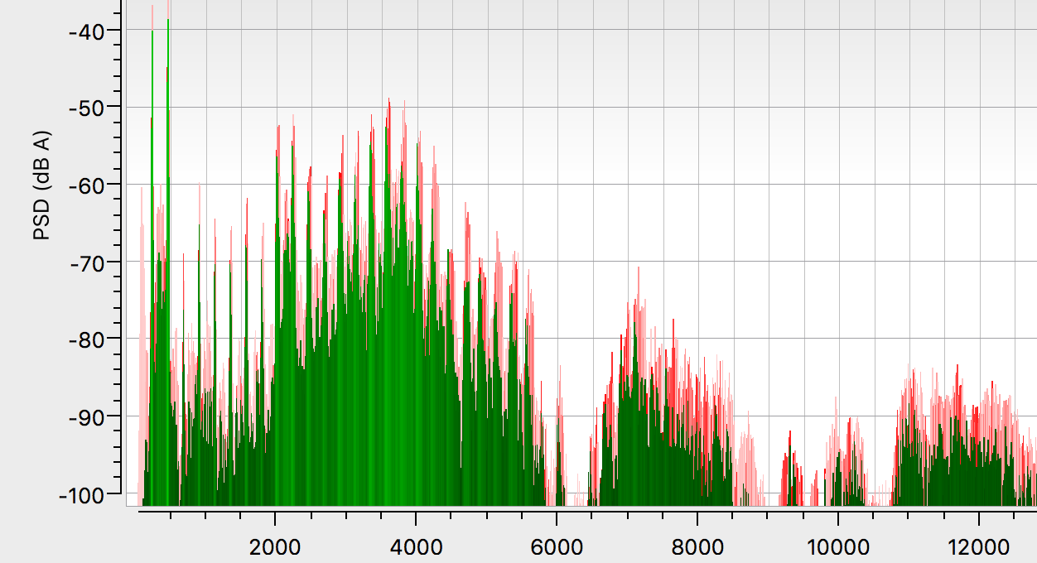
Sound representation
Many different representations
Highlight different aspects of acoustic information
www.friture.org

Slide 10
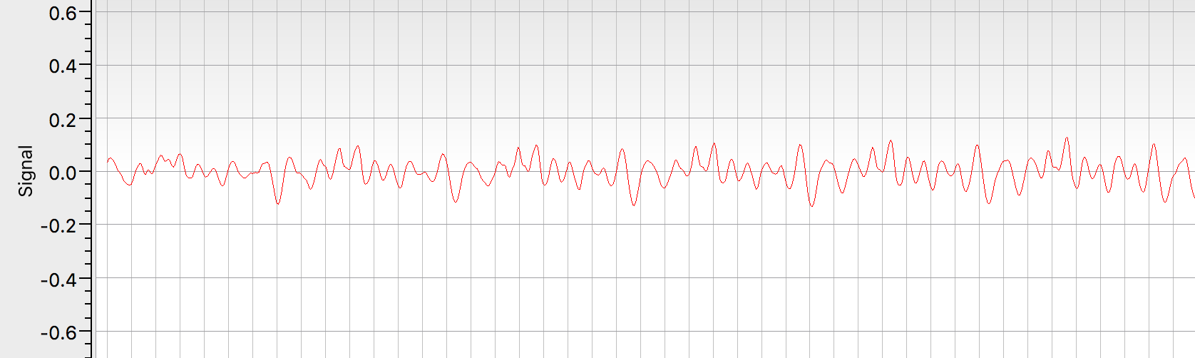
Sound representation
Temporal representation
Demo : speech, periodic sounds, noise, pure tone…
www.friture.org

Slide 11
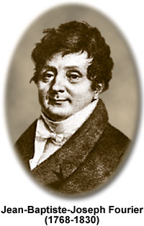
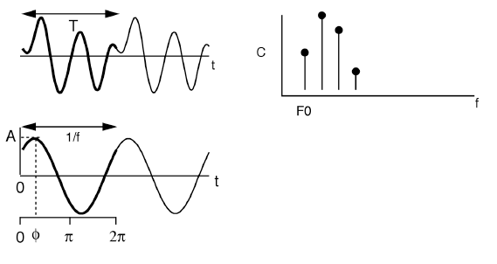
Sound representation
Spectral representation
All sounds can be decomposed into a sum of pure tones [disclaimer: not an actual quote!]
Fourier transform
Equivalent representation: projection into frequency space

Slide 12
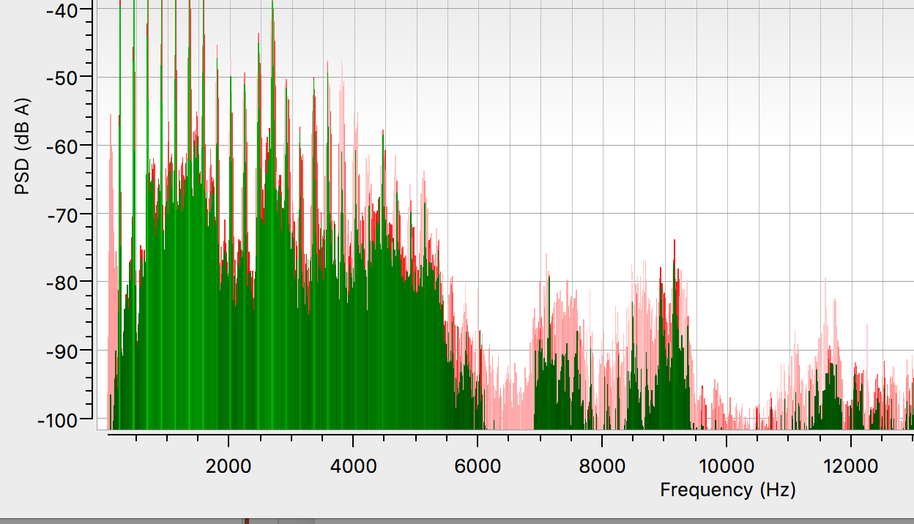
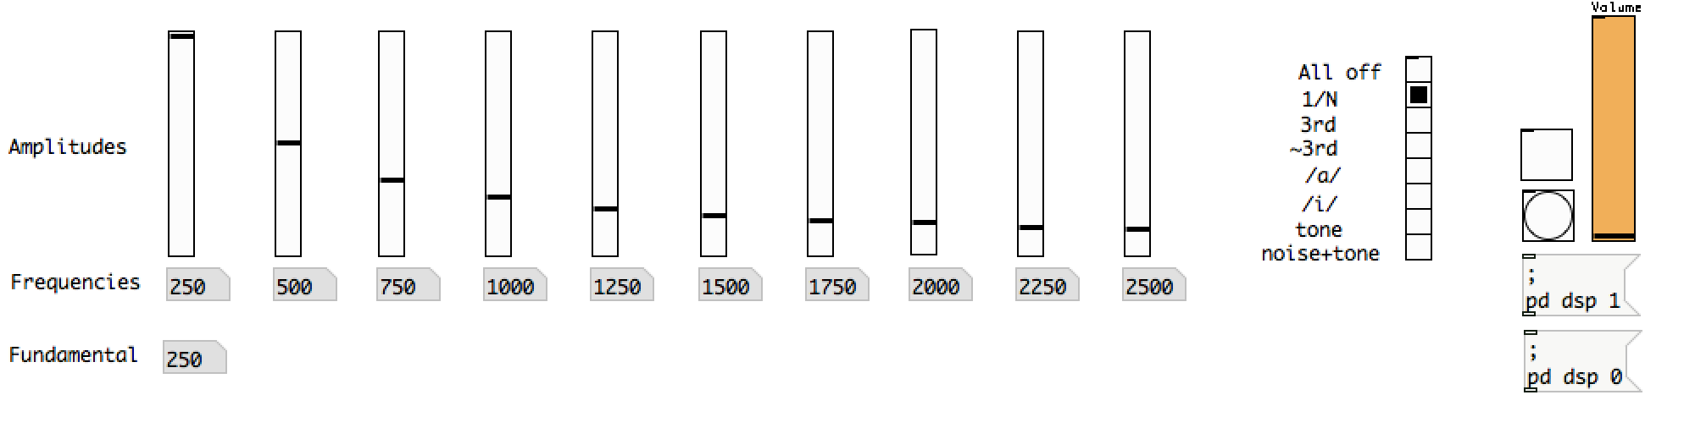
Sound representation
Spectral representation
Demo: speech, periodic sounds, noise, pure tone…
Demo additive synthesis
www.puredata.info
www.friture.org

Slide 13
Sound representation
Spectro-temporal representation
Represent spectral content over a limited temporal support
Many possible representations
Demo : short-term Fourier transform (STFT)
www.friture.org

Slide 14
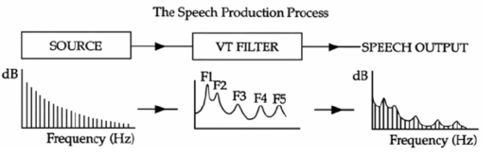
Sound representation
Signal processing
Tools to manipulate sounds
Example: Filtering
Linear combination of samples or frequency multiplication

Slide 15
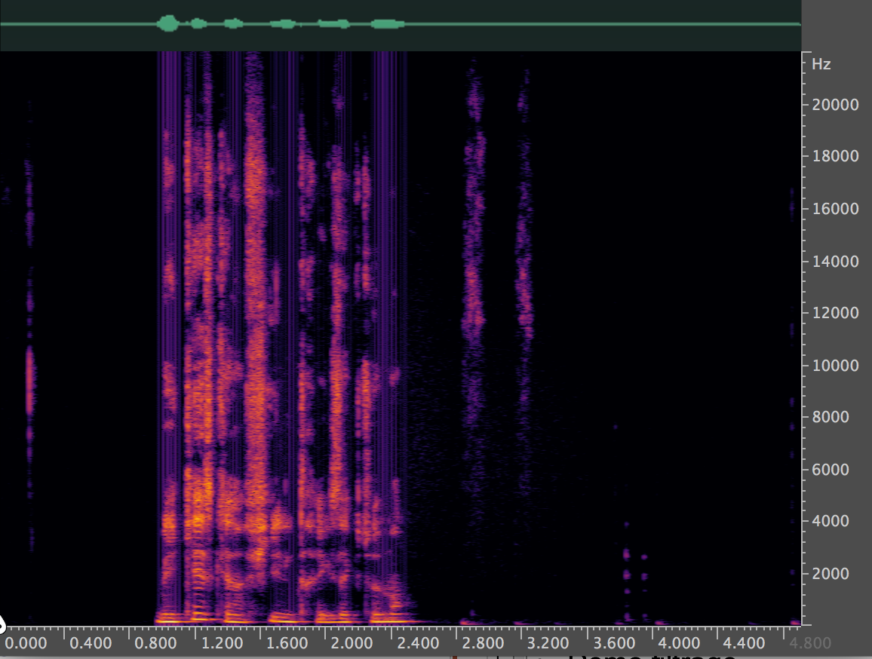
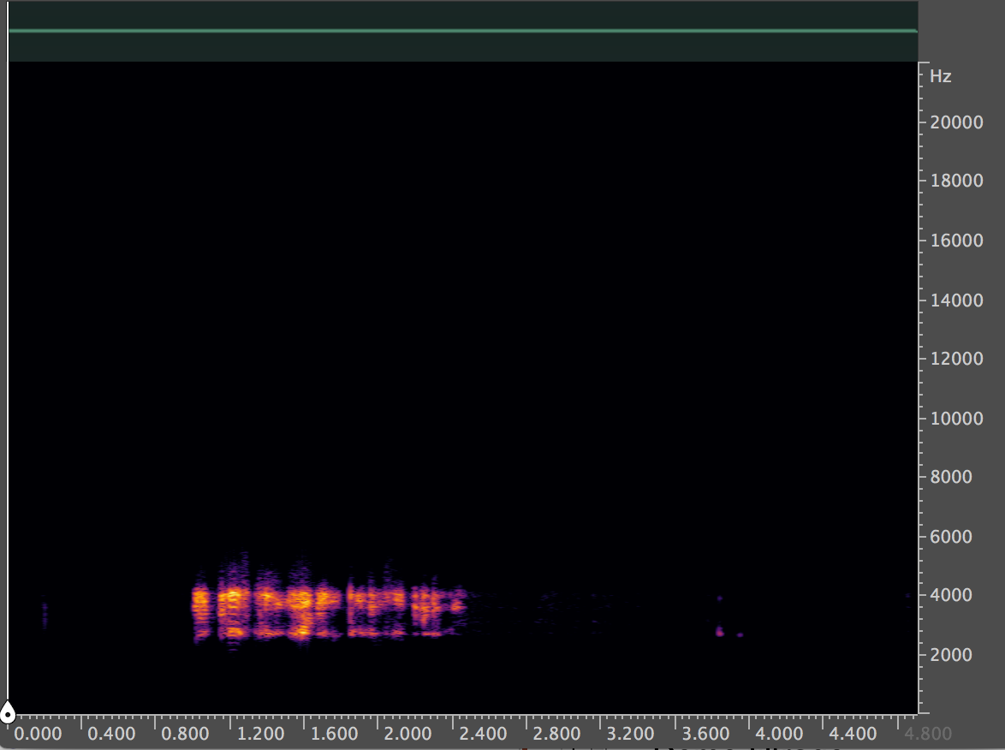
Sound representation
Signal processing
Demo: filtering
Analogy with auditory peripheral processing
www.ocenaudio.com

Slide 16



Sound representation
Summary
One physical phenomenom, several representations
Tools available to represent and manipulate sounds
Not shown here: how to generate sounds for experiments

Slide 17
Sound representation
Summary
Fundamentally different from “perception”: - not sufficient (e.g. ultrasound) - not necessary (e.g. tinnitus) - frequency is not pitch (more on that later)
-> Map sound representations and sensation?

Slide 18
Overview
I. Methods and concepts acoustics, psychophysics, physiology
II. Basic characteristics and applications audible range, masking, critical band, non-linearities, MP3, implants
III. Perceptual attributes loudness, pitch, timbre, location
IV. Seminar auditory scene analysis, illusions, memory

Slide 19
Psychophysics
G.T. Fechner
The exact science of the functional relations or relations of dependency between body and mind, or more generally between the bodily and mental, the physical and psychical world. Fechner, 1860
October 18, 1850 in Leipzig : birth of the psychophysics project
Measuring sensations
A bit of a problem: sensations are fundamentally private
-> A rigorous experimental method

Slide 20
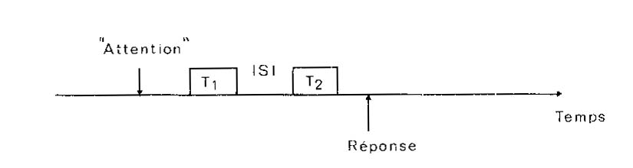
Psychophysics
Detection threshold
Measuring the smallest detectable « intensity »

Slide 21
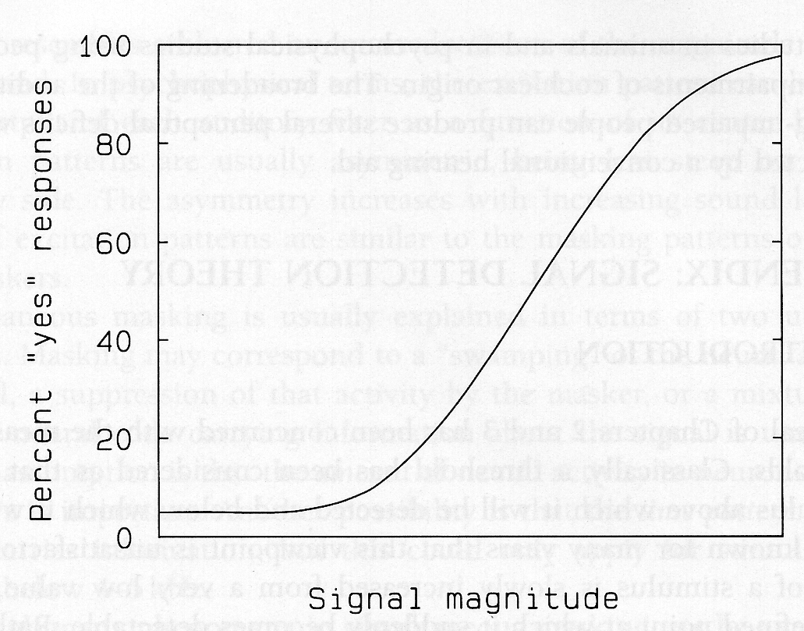
Psychophysics
Detection threshold
The psychometric function

Slide 22
Psychophysics
Not there yet…
Fechner wants to map physics and sensation
S = f(φ)

Slide 23
Psychophysics
Just noticeable difference
Measuring the smallest detectable difference in intensity

Slide 24
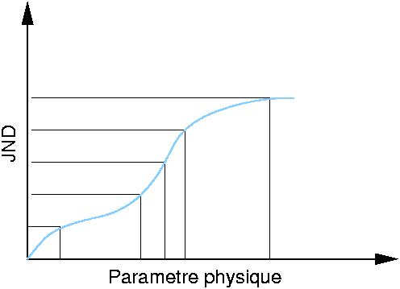
Psychophysics
Psychophysical function
Hypothesis: 1 jnd = 1 unit of sensation

Slide 25
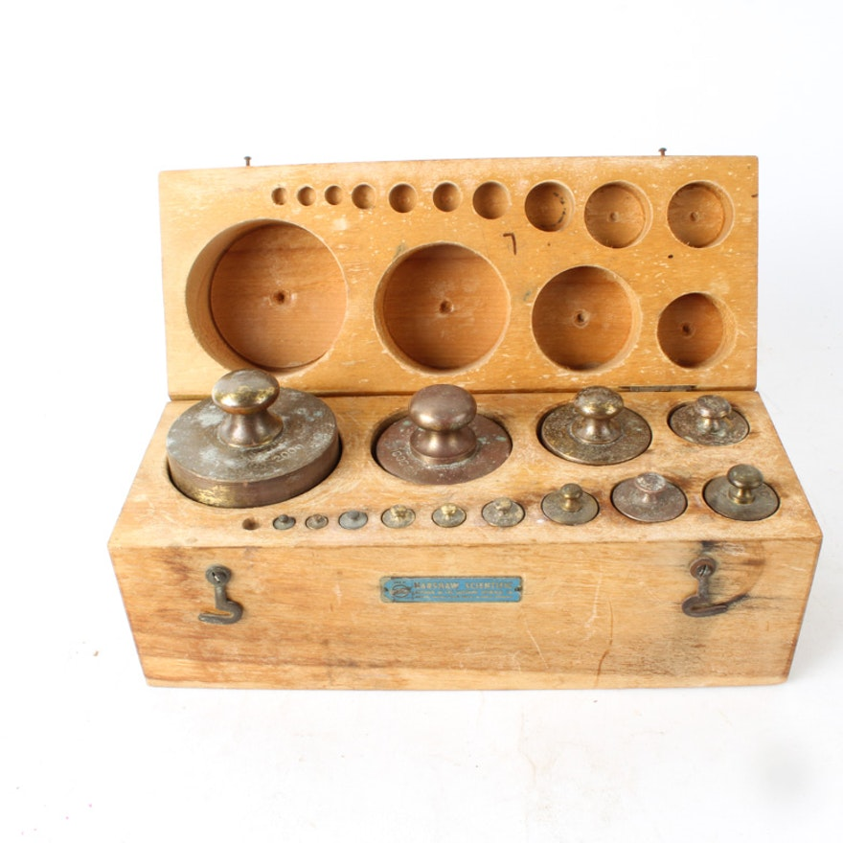
Psychophysics
G.T. Fechner
E.H. Weber
Weber-Fechner law : ∆I/I = constant
⇒ S ~ log(I)

Slide 26
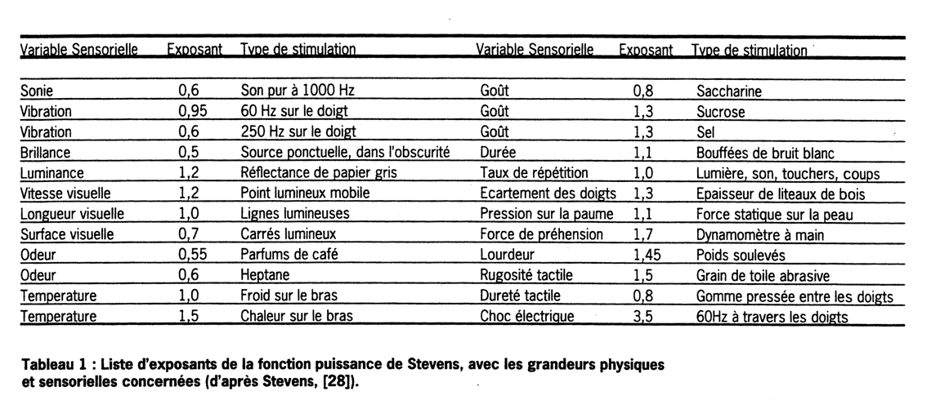
Psychophysics
Other methods
Direct estimation
Stevens’ law: S ~ φ^{k}

Slide 27
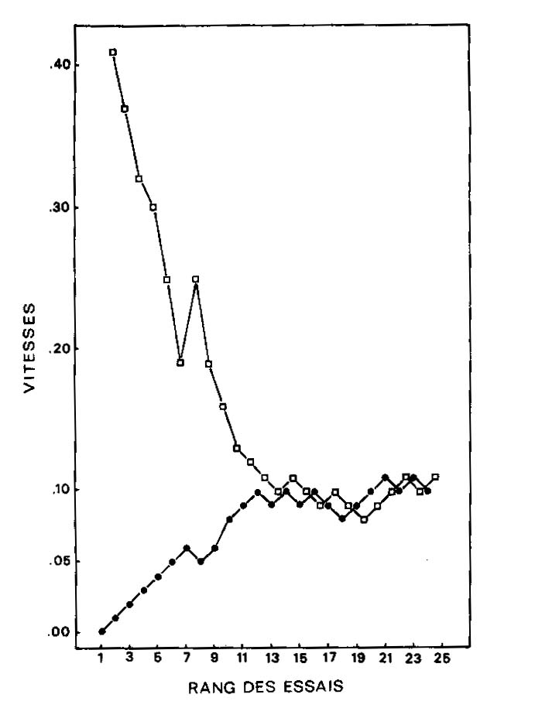
Psychophysics
Other methods
Adaptative measurement of thresholds

Slide 28
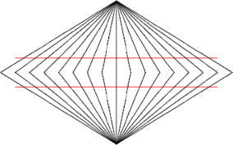
Psychophysics
W.M. Wundt
Why does not psychology follow the example of the natural sciences? It is an understanding that, from every side of the history of the natural sciences, informs us that the progress of every science is closely connected with the progress made regarding experimental methods. W. Wundt, 1862
1st Experimental Psychology lab in1879, in Leipzig
Systematic introspection
Measure sensations and beyond : “aperception”, memory, …

Slide 29
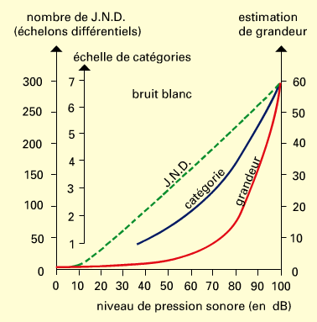
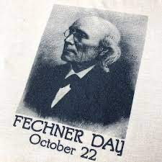
Psychophysics
Conclusion
A widely successful endeavor: behavior, neuroscience, models
Measurement method can impact results?
-> Not uncommon in experimental sciences

Slide 30
Overview
I. Methods and concepts acoustics, psychophysics, physiology
II. Basic characteristics and applications audible range, masking, critical band, non-linearities, MP3, implants
III. Perceptual attributes loudness, pitch, timbre, location
IV. Seminar auditory scene analysis, illusions, memory

Slide 31
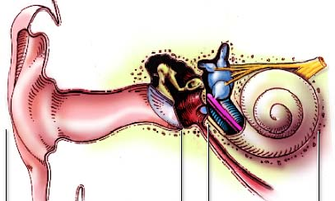


Physiology
Peripheral auditory system
Outer ear, middle ear, inner ear

Slide 32
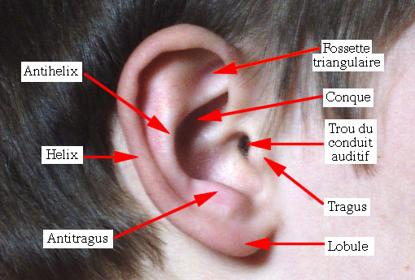
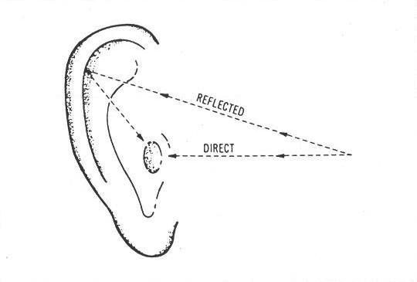
Physiology
Outer ear
Unique shape to each person
Amplification from pinna + ear canal: +15 dB around ˜2kHz
Also important for sound localization

Slide 33
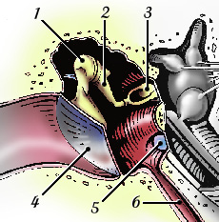
Physiology
Middle ear
1. Malleus
2. Incus
3. Stapes
4. Eardrum
5. Round window
6. Eustachian tube
Amplifcation eardrum/ossicles: +25 dB around ~ 2 kHz
Stapedian réflex: attenuation from contralateral stimulation

Slide 34
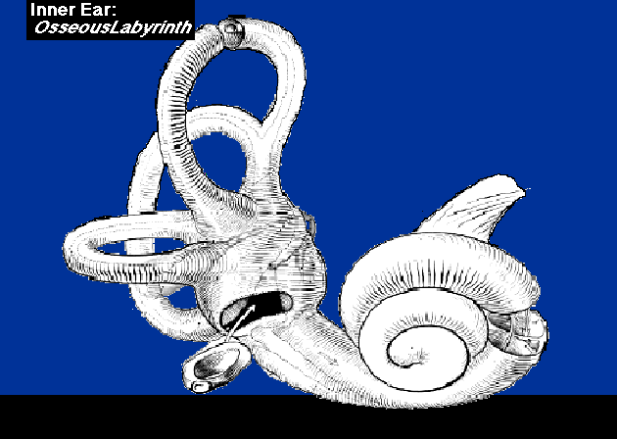
Physiology
Inner ear

Slide 35

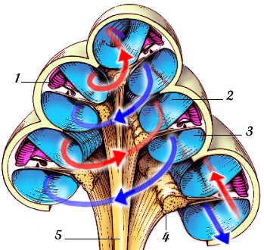
Physiology
The cochlea
1. Cochlear duct
2. Scala vestibular
3. Scala tympani
4. Spiral ganglion
5. Auditory nerve
Basilar membrane

Slide 36
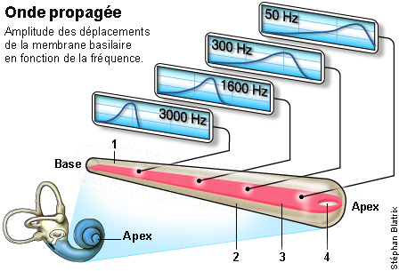
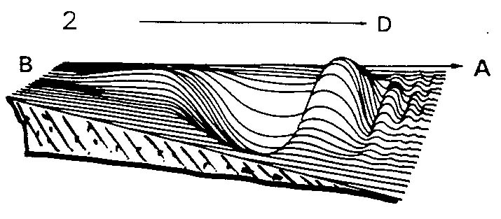
Physiology
Basilar membrane
Notes:
`

Slide 37
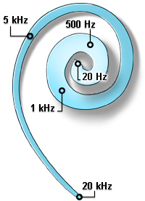
Physiology
Basilar membrane
Tonotopic coding

Slide 38
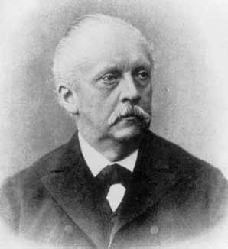
Physiology
Die Lehre von den Tonempfindungen als Physiologische Grundlage für die Theorie der Musik (1877)

Slide 39
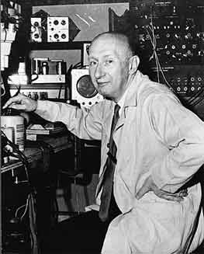
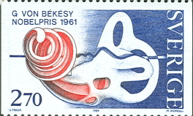
Physiology

Slide 40
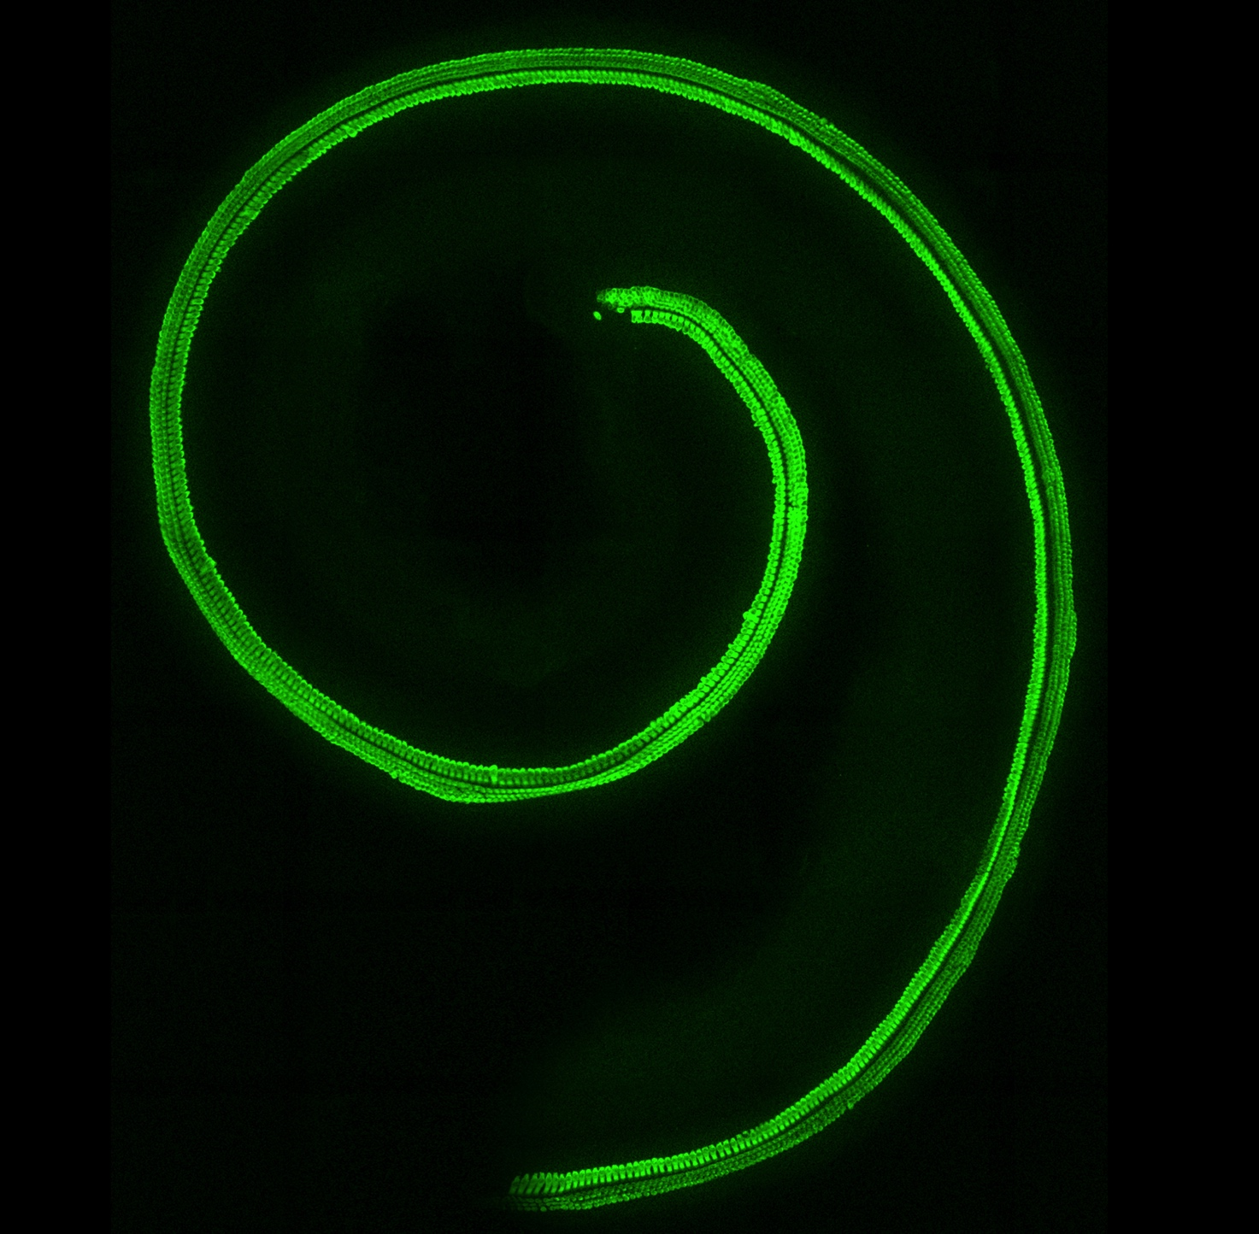
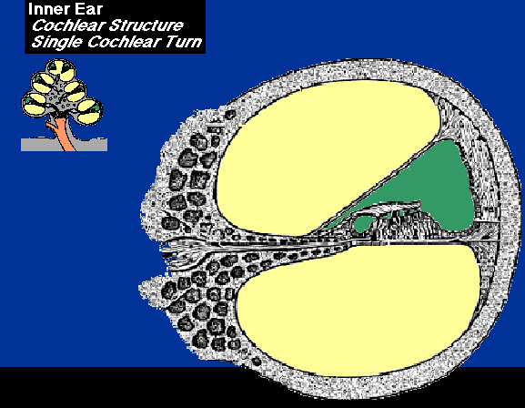
Physiology
Organ of Corti
© Saaid Safieddine

Slide 41
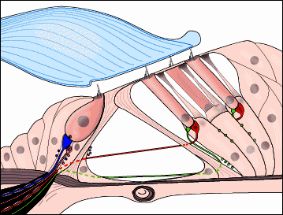
I.3 Physiologie
Organ of Corti
Outer hair cells
Inner hair cell

Slide 42
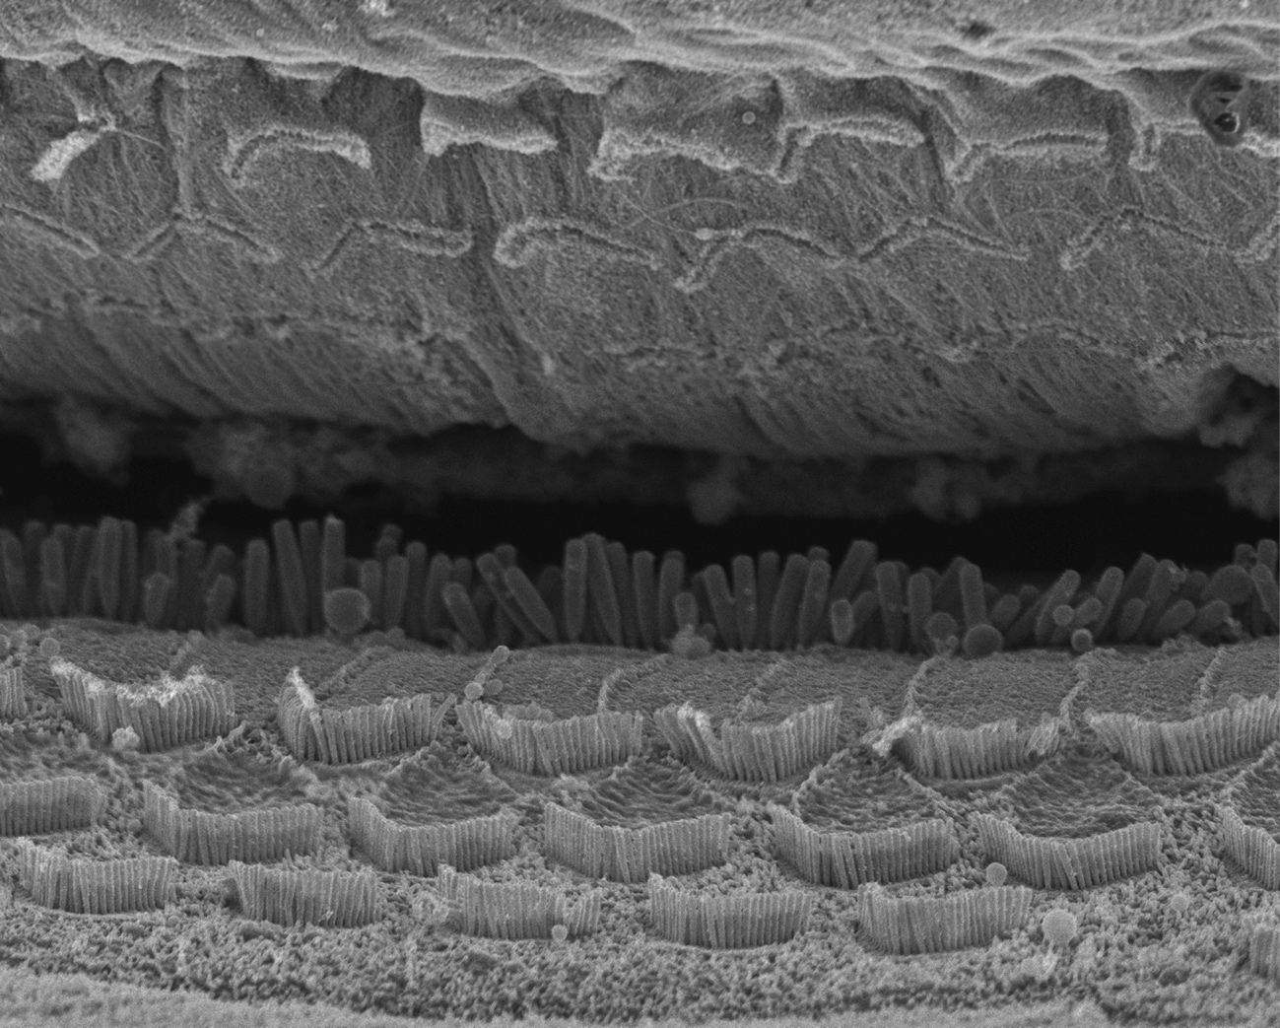
Physiology
Hair cells
© Vincent Michel

Slide 43
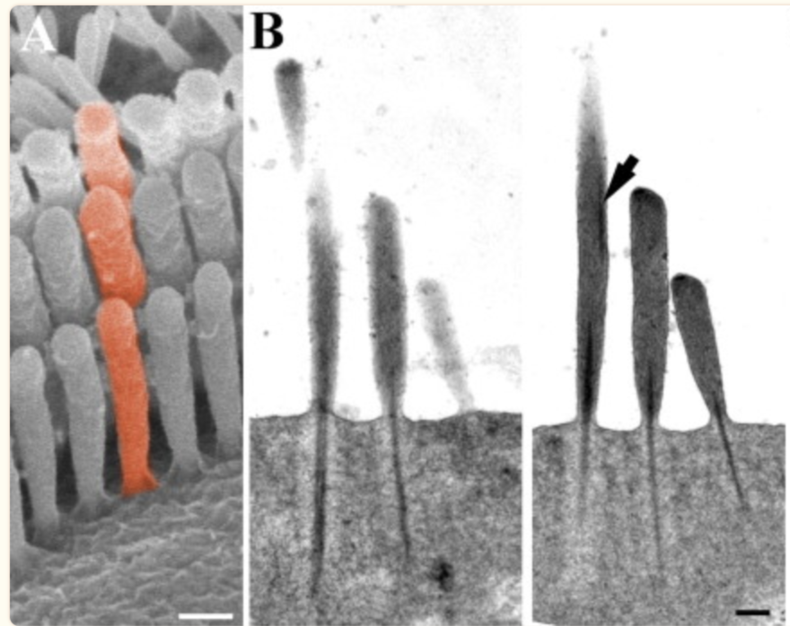
Physiology
Inner hair cells
Scale bars: 200 nm
Furness et al., J Neurosci 2008

Slide 44
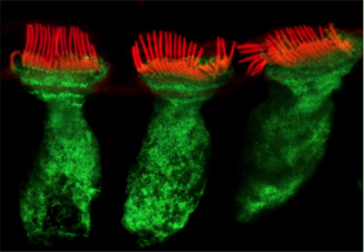
Physiology
Inner hair cells
© Vincent Michel

Slide 45
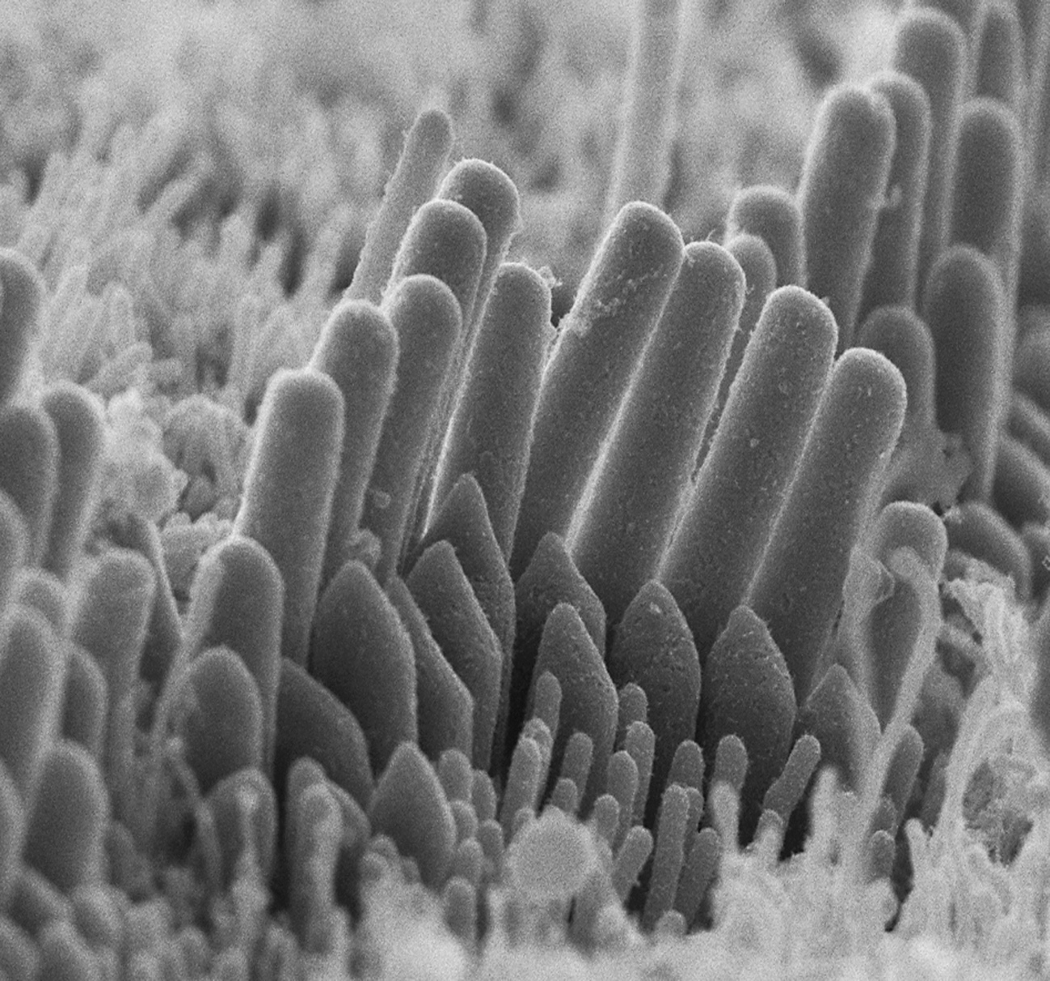
Physiology
Inner hair cells
© Vincent Michel

Slide 46
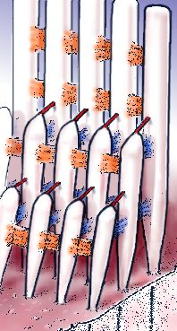

I.3 Physiologie
Inner hair cells
Transduction
Phase locking
Temporal coding

Slide 47

Physiology
Outer hair cells
© Vincent Michel

Slide 48
Physiology
© Vincent Michel

Slide 49


Physiology
Outer hair cells
Electromotility
Ashmore, Physiol. Rev. 88: 173-210, 2008

Slide 50


Physiology
Outer hair cells
Electromotility
The active mechanism: amplification and selectivity

Slide 51



Physiology
Acoustic trauma

Slide 52

Physiology
Auditory nerve
30000 afferent fibers
Type 1: 90%, inner hair cells
Type 2: 10%, outer hair cells
1500 efferent fibers, outer hair cells

Slide 53

Physiology
Auditory nerve
Characteristic frequency determined by tonotopy

Slide 54


Physiology
Auditory nerve
Phase locking in the nerve
Upper frequency limit on accurate phase locking

Slide 55

Physiology
Auditory nerve
Different types of afferent fibres

Slide 56

Physiology
And then?
Many sub-cortical processing stages

Slide 57

Physiology
And then?
© Sam Norman-Haigneré
Many cortical processing stages

Slide 58

Physiology
Auditory pathways
Wimmer, Nevia, & Kuner., 2004
Coomber et al., 2015
Anatomic variety starting from cochlear nucleus

Slide 59

Physiology
Auditory pathways
© Thomas Kuner
Xiao et al., Nat Neuro, 2013
The biggest synapse in the human brain (calyx of Held)

Slide 60
Physiology
Y. Boubenec
A. de Cheveigné

